Slide 1
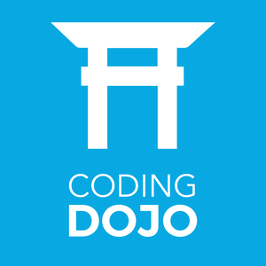
Java Coding Dojo (Session 1)

Slide 2
What is coding dojo and how work?
A Coding Dojo is a meeting where a bunch of coders get together to work on a programming challenge. They are there to have fun and to engage inDeliberatePracticeÂ in order to improve their skills.
Premises
Acquiring coding skills should be a continuous process
Katas: "an individual training exercise in karate and other martial arts"
These are exercises where there is only a problem description, the exercise is to implement a solution.
You can (and should) implement and re-implement katas many times.
This Code Dojo youâ€™ll practise a kata in the Java programming language. During this kata youâ€™ll learn and apply some techniques to get to Clean Code.
This will give you the practise of solving different type of problems, and every time you solve it again you will become quicker and better at it.
These exercises are also perfect to learn new programming languages, or new features of programming languages. eg. by implementing a kata in Java 6, Java 7, Java 8, Scala, Ruby, Groovy, etc. Youâ€™ll quickly learn the specifics of each of the languages.
Types of Meeting (how coding dojo work): Prepared Kata and RandoriKata
http://codingdojo.org/WhatIsCodingDojo/
https://bolcom.github.io/student-dojo/#how-does-this-workshop-work

Slide 3
How does this workshop work?
First part: Theory
Second: Practice
Third: Recommendation to improve the Coding Dojo

Slide 4
Coding Dojo Rules
- Respect
- No one know more than other. We all are equal
- Help your peer
- Be cool
- Repeat until you know and do it fast…..

Slide 8
TDD
What is TDD?
https://bolcom.github.io/student-dojo/#how-does-this-workshop-work

Slide 9
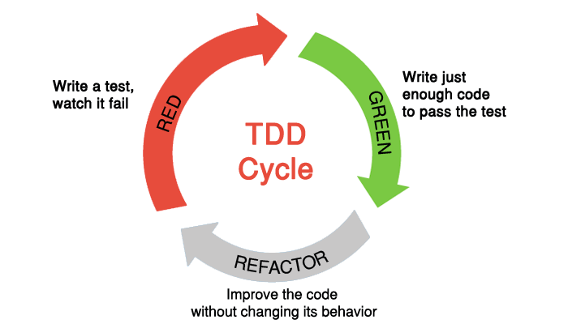
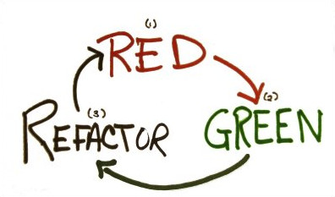
TDD Cycle
(red) Create a unit tests that fails
(green) Write production code that makes that test pass
(Refactor) Clean up the mess you just made
https://bolcom.github.io/student-dojo/#how-does-this-workshop-work

